Slide 1
WHERE TO OPEN A VIRTUAL REALITY BAR IN NORTH YORK?

Slide 2
TABLE OF CONTENT
PROBLEM DESCRIPTION + INPUT
METHODOLOGY
RESULTS

Slide 3
PROBLEM DESCRIPTION + INPUT
- problem: identify best location in North York, Ontario to open up a Virtual Reality bar.
- assumptions: number of available students is main driving factor (others: number of nearby gaming centers, % of low income households)
- input: school data from the government of Ontario necessary location data about the nearby gaming centers via Foursquare

Slide 4
METHODOLOGY
1 collect & clean data
2 get the nearby gaming centers via foursquare engine
3 define ratio available students per school
4 Cluster in 6 classes based on the Kmeans algorithm based on number of gaming centers, enrol gaming center ratio & % of low income households.

Slide 5
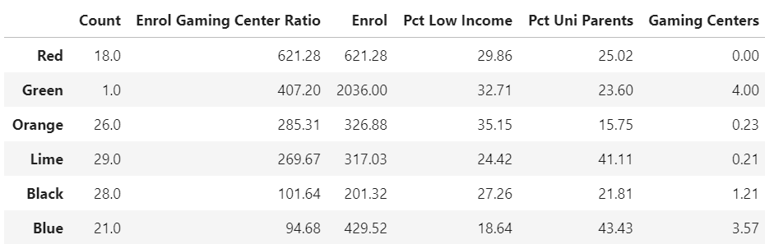
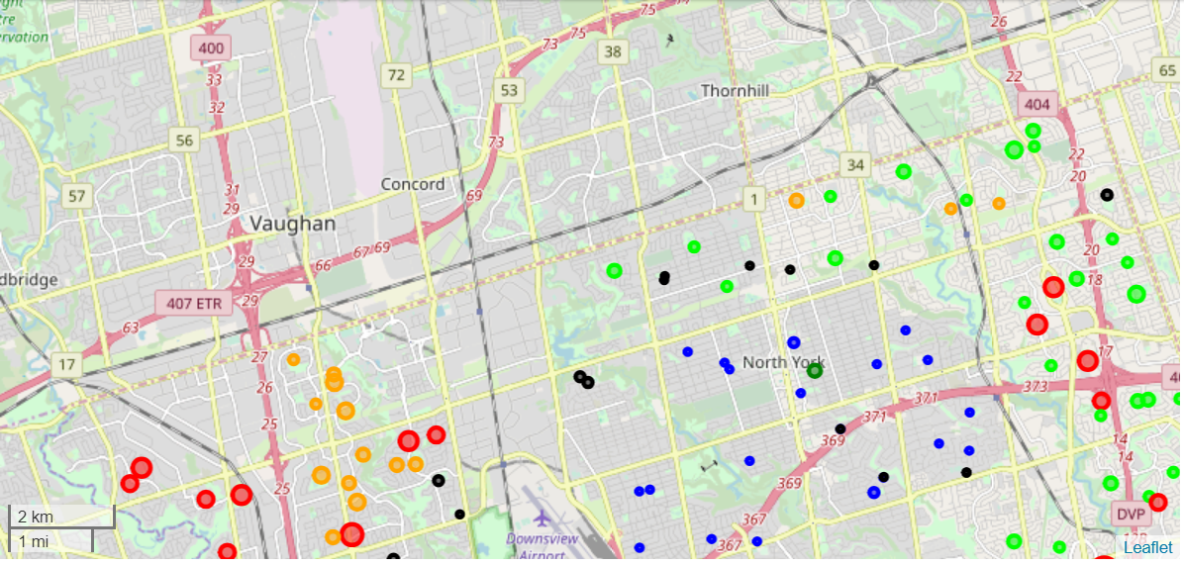
RESULTS
Red cluster highest score (East & West of North York)
% of low income households lower in lime than orange cluster
Advise: Open a VR bar in the EAST of North York

